Slide 1
Introductory General Chemistry
Chemistry 3A
S. M. Halloran

Slide 2
Stoichiometry: mass, solution, gas, acid-base titration
Limiting Reagent/Reactant
Theoretical and Percent Yield
Changes in Enthalpy

Slide 3

General Stoichiometry
Stoichiometry: study of quantities in chemical reactions
2 H₂ + O₂ → 2 H₂O
“two moles hydrogen react with one mole oxygen to produce two moles of water”
Ratios we can deduce
$\frac{2 mol H2}{1 mol O2}$, $\frac{1 mol O2}{2 mol H2}$, $\frac{2 mol H2O}{1 mol O2}$, $\frac{1 mol O2}{2 mol H2O}$, $\frac{2 mol H2}{2 mol H2O}$, $\frac{2 mol H2O}{2 mol H2}$
These will be part of calculations that have been already done in this course and to estimate yields

Slide 4

Moles Reactant / Moles Product
How many moles of oxygen (O₂) will react with hydrogen (H₂) to produce 27.6 mol H₂O?
To solve: moles O₂
Determine the BALANCED reaction:
Skeletal reaction: H₂ + O₂ → H₂O
Balanced reaction: 2 H₂ + O₂ → 2 H₂O
Identify needed quantities: 27.6 mol H₂O product
Conversion factor: 1 mol O₂ / 2 mol H₂O
Substitute values & solve: $27.6 mol H2O×\frac{1 mol O2}{2 mol H2O}=13.8 mol O2$

Slide 5
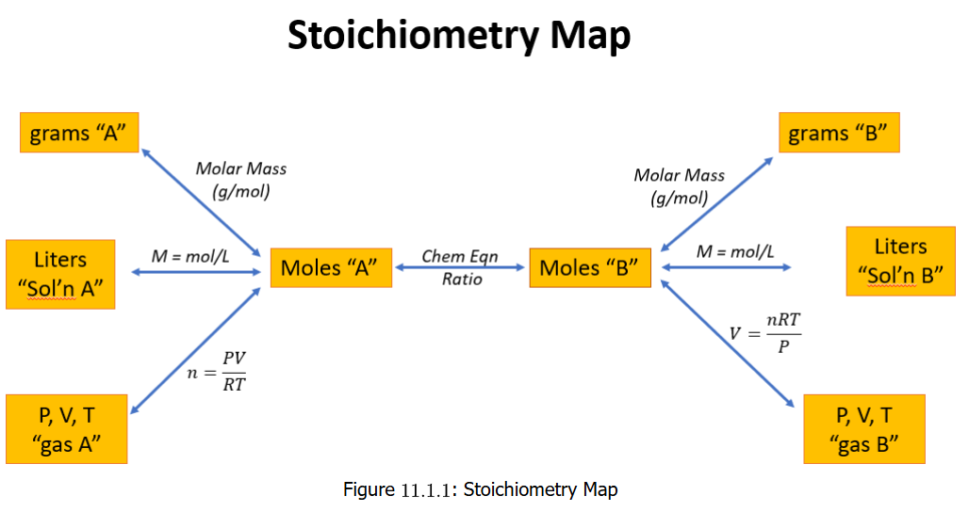
Stoichiometry Map
To reinforce understanding of how certain conversions are done in quantitative chemistry, this visual “map” is found useful to some

Slide 6
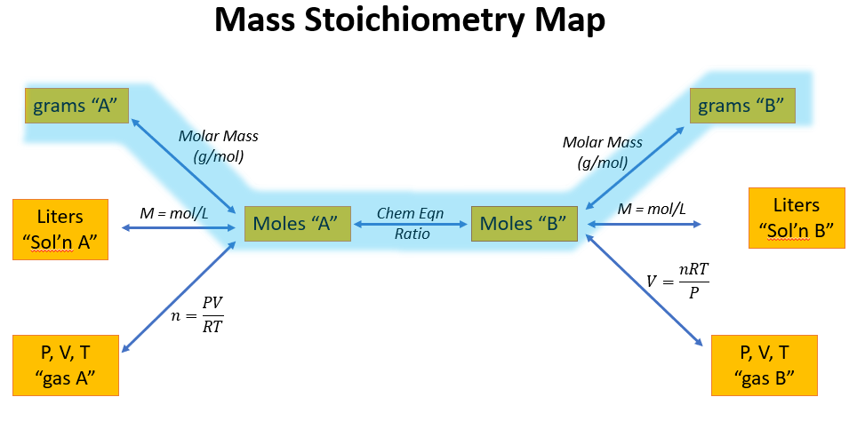
The Mass-to-Mass Pathway
The mass (grams) of compound A to mass (grams) of compound B shows that it is first necessary to convert to moles in order to relate atom-for-atom reaction in a chemical reaction equation

Slide 7
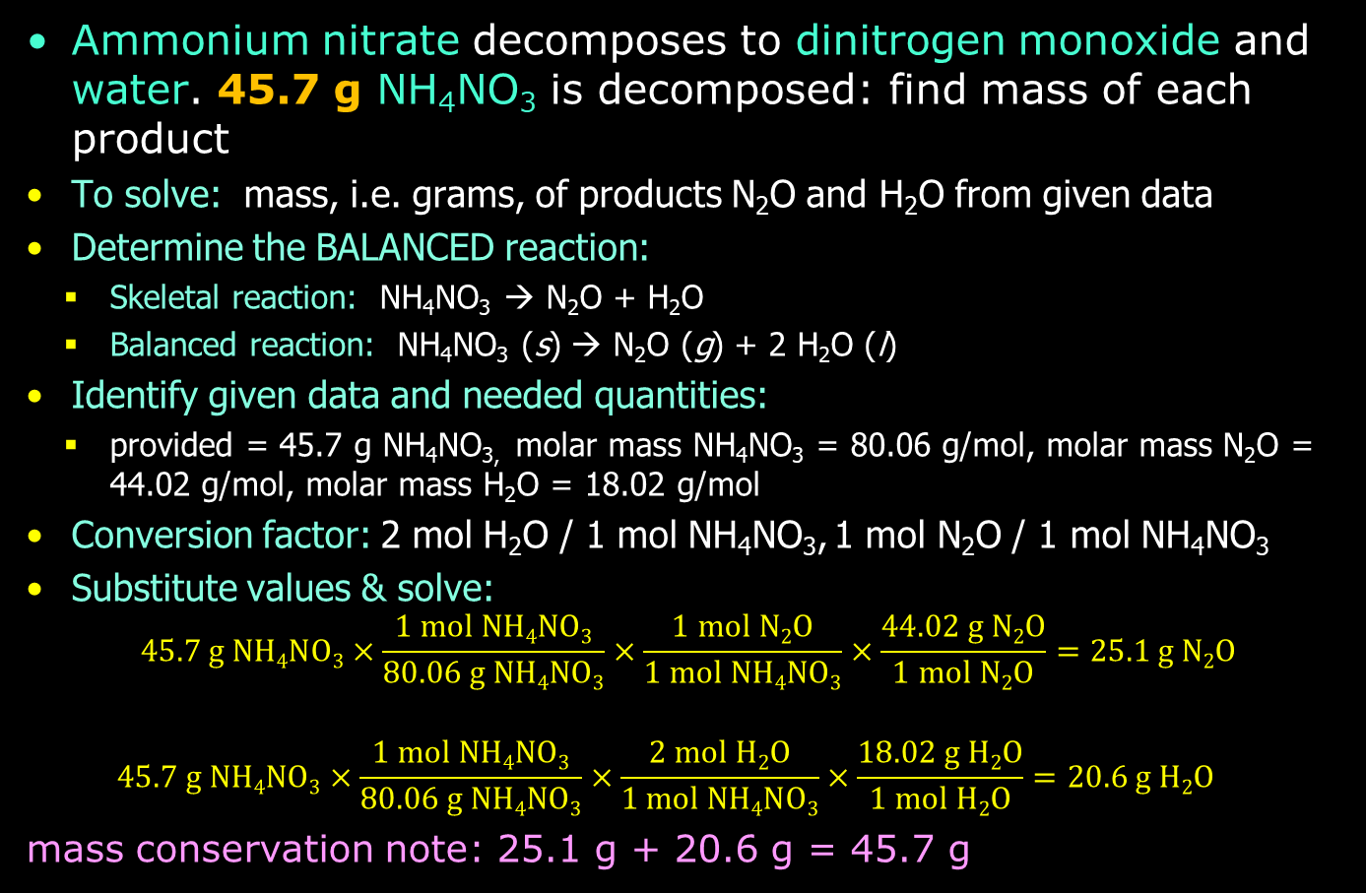
Example: Mass-to-Mass
Ammonium nitrate decomposes to dinitrogen monoxide and water. 45.7 g NH₄NO₃ is decomposed: find mass of each product
To solve: mass, i.e. grams, of products N₂O and H₂O from given data
Determine the BALANCED reaction:
Skeletal reaction: NH₄NO₃ → N₂O + H₂O
Balanced reaction: NH₄NO₃ (s) → N₂O (g) + 2 H₂O (l)
Identify given data and needed quantities:
provided = 45.7 g NH₄NO_{3,} molar mass NH₄NO₃ = 80.06 g/mol, molar mass N₂O = 44.02 g/mol, molar mass H₂O = 18.02 g/mol
Conversion factor: 2 mol H₂O / 1 mol NH₄NO₃, 1 mol N₂O / 1 mol NH₄NO₃
Substitute values & solve: $45.7 g NH4NO3×\frac{1 mol NH4NO3}{80.06 g NH4NO3}×\frac{1 mol N2O}{1 mol NH4NO3}×\frac{44.02 g N2O}{1 mol N2O}=25.1 g N2O$ $45.7 g NH4NO3×\frac{1 mol NH4NO3}{80.06 g NH4NO3}×\frac{2 mol H2O}{1 mol NH4NO3}×\frac{18.02 g H2O}{1 mol H2O}=20.6 g H2O$
mass conservation note: 25.1 g + 20.6 g = 45.7 g

Slide 8
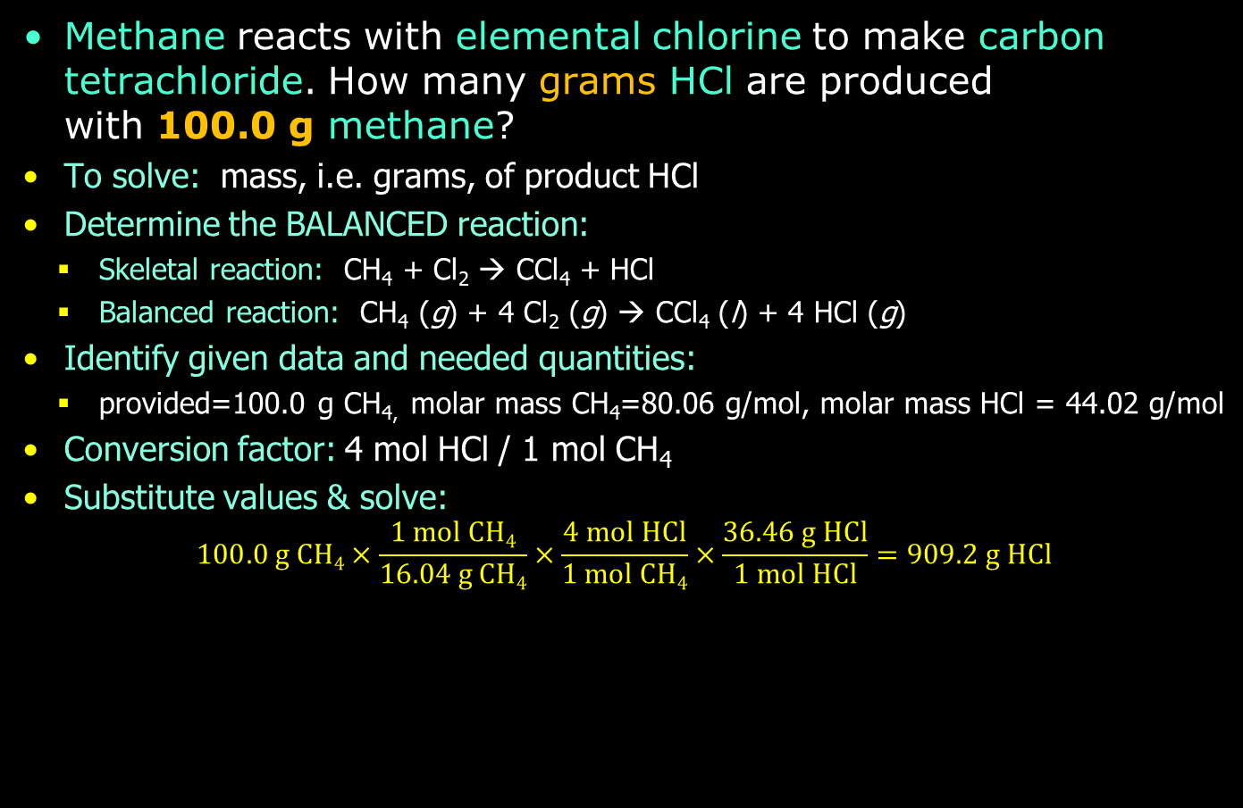
Practice: Mass-to-Mass
Methane reacts with elemental chlorine to make carbon tetrachloride. How many grams HCl are produced with 100.0 g methane?
To solve: mass, i.e. grams, of product HCl
Determine the BALANCED reaction:
Skeletal reaction: CH₄ + Cl₂ → CCl₄ + HCl
Balanced reaction: CH₄ (g) + 4 Cl₂ (g) → CCl₄ (l) + 4 HCl (g)
Identify given data and needed quantities:
provided=100.0 g CH_{4,} molar mass CH₄=80.06 g/mol, molar mass HCl = 44.02 g/mol
Conversion factor: 4 mol HCl / 1 mol CH₄
Substitute values & solve: $100.0 g CH4×\frac{1 mol CH4}{16.04 g CH4}×\frac{4 mol HCl}{1 mol CH4}×\frac{36.46 g HCl}{1 mol HCl}=909.2 g HCl$

Slide 9
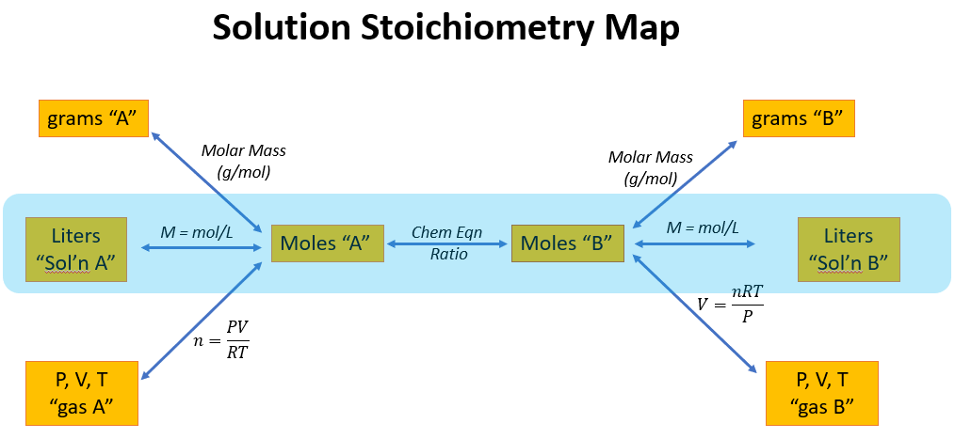
Solution Stoichiometry
This conversion pathway uses a volume to get the amount in moles of a substance. It requires knowing a concentration—molarity—for the solution where the problem is to be solved

Slide 10
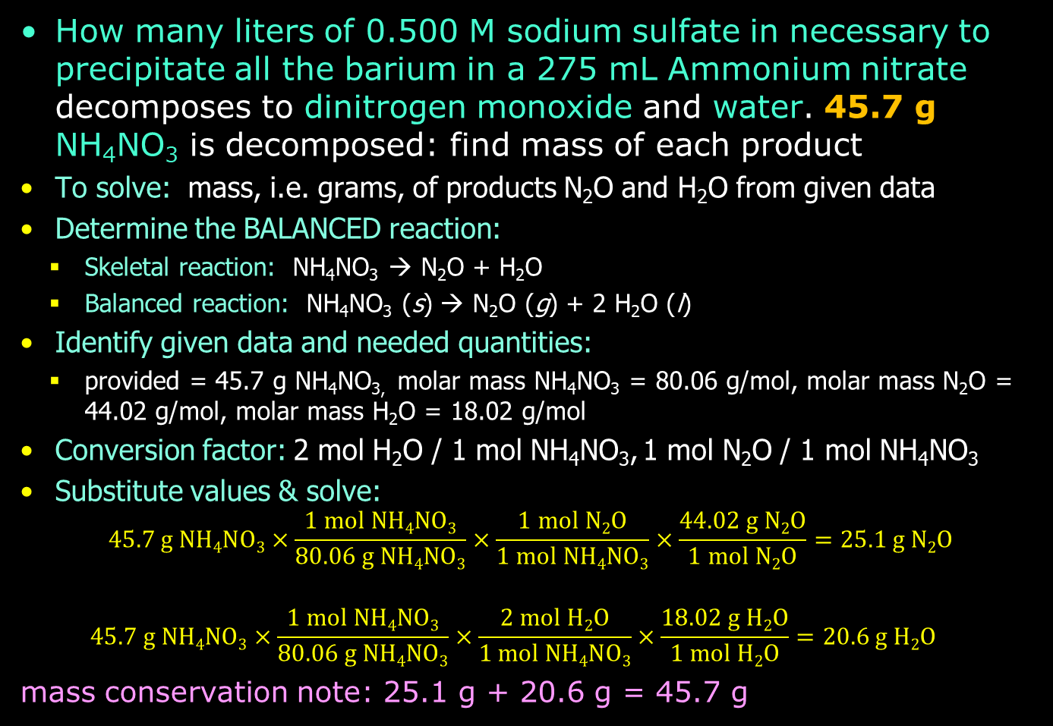
Example: Volume Calculations
How many liters of 0.500 M sodium sulfate in necessary to precipitate all the barium in a 275 mL Ammonium nitrate decomposes to dinitrogen monoxide and water. 45.7 g NH₄NO₃ is decomposed: find mass of each product
To solve: mass, i.e. grams, of products N₂O and H₂O from given data
Determine the BALANCED reaction:
Skeletal reaction: NH₄NO₃ → N₂O + H₂O
Balanced reaction: NH₄NO₃ (s) → N₂O (g) + 2 H₂O (l)
Identify given data and needed quantities:
provided = 45.7 g NH₄NO_{3,} molar mass NH₄NO₃ = 80.06 g/mol, molar mass N₂O = 44.02 g/mol, molar mass H₂O = 18.02 g/mol
Conversion factor: 2 mol H₂O / 1 mol NH₄NO₃, 1 mol N₂O / 1 mol NH₄NO₃
Substitute values & solve: $45.7 g NH4NO3×\frac{1 mol NH4NO3}{80.06 g NH4NO3}×\frac{1 mol N2O}{1 mol NH4NO3}×\frac{44.02 g N2O}{1 mol N2O}=25.1 g N2O$ $45.7 g NH4NO3×\frac{1 mol NH4NO3}{80.06 g NH4NO3}×\frac{2 mol H2O}{1 mol NH4NO3}×\frac{18.02 g H2O}{1 mol H2O}=20.6 g H2O$
mass conservation note: 25.1 g + 20.6 g = 45.7 g

Slide 11
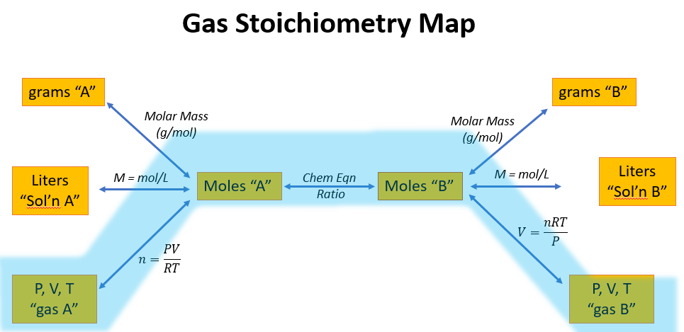
Moles Reactant / Moles Product

Slide 12
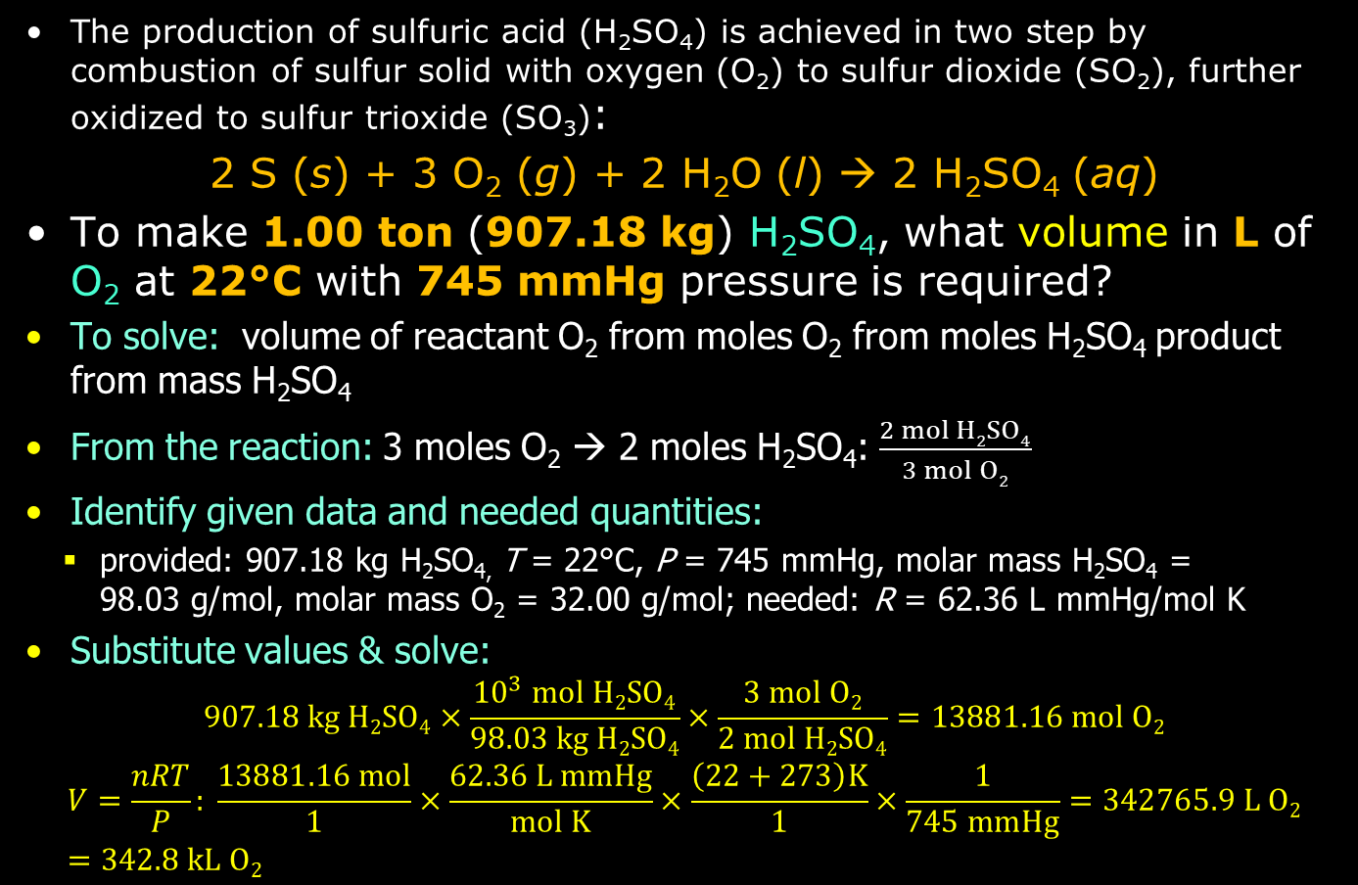
Example: Gas Calculations
The production of sulfuric acid (H₂SO₄) is achieved in two step by combustion of sulfur solid with oxygen (O₂) to sulfur dioxide (SO₂), further oxidized to sulfur trioxide (SO₃):
2 S (s) + 3 O₂ (g) + 2 H₂O (l) → 2 H₂SO₄ (aq)
To make 1.00 ton (907.18 kg) H₂SO₄, what volume in L of O₂ at 22°C with 745 mmHg pressure is required?
To solve: volume of reactant O₂ from moles O₂ from moles H₂SO₄ product from mass H₂SO₄
From the reaction: 3 moles O₂ → 2 moles H₂SO₄: $\frac{2 mol H2SO4}{3 mol O2}$
Identify given data and needed quantities:
provided: 907.18 kg H₂SO_{4,} T = 22°C, P = 745 mmHg, molar mass H₂SO₄ = 98.03 g/mol, molar mass O₂ = 32.00 g/mol; needed: R = 62.36 L mmHg/mol K
Substitute values & solve: $907.18 kg H2SO4×\frac{{10}^{3} mol H2SO4}{98.03 kg H2SO4}×\frac{3 mol O2}{2 mol H2SO4}=13881.16 mol O2$
$$V=\frac{nRT}{P}: \frac{13881.16 mol}{1}×\frac{62.36 L mmHg}{mol K}×\frac{\left(22+273\right)K}{1}×\frac{1}{745 mmHg}=342765.9 L O2=342.8 kL O2$$

Slide 13
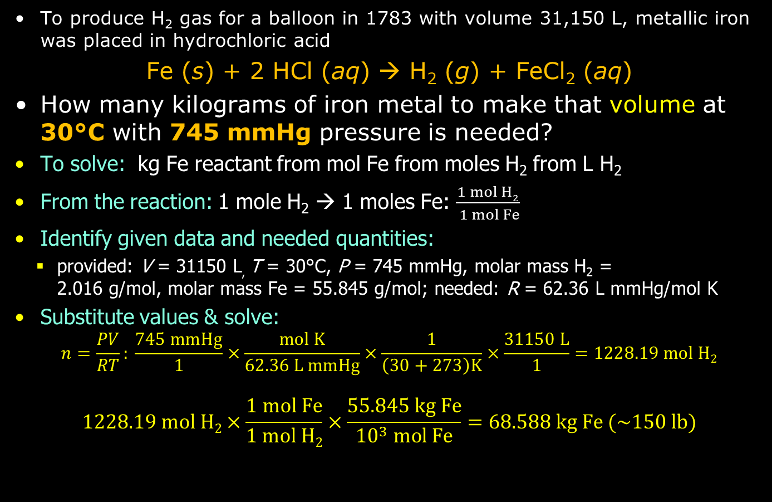
Example: Gas Calculations
To produce H₂ gas for a balloon in 1783 with volume 31,150 L, metallic iron was placed in hydrochloric acid
Fe (s) + 2 HCl (aq) → H₂ (g) + FeCl₂ (aq)
How many kilograms of iron metal to make that volume at 30°C with 745 mmHg pressure is needed?
To solve: kg Fe reactant from mol Fe from moles H₂ from L H₂
From the reaction: 1 mole H₂ → 1 moles Fe: $\frac{1 mol H2}{ 1 mol Fe}$
Identify given data and needed quantities:
provided: V = 31150 L, T = 30°C, P = 745 mmHg, molar mass H₂ = 2.016 g/mol, molar mass Fe = 55.845 g/mol; needed: R = 62.36 L mmHg/mol K
Substitute values & solve: $n=\frac{PV}{RT}: \frac{745 mmHg}{1}×\frac{mol K}{62.36 L mmHg}×\frac{1}{\left(30+273\right)K}×\frac{31150 L}{1}=1228.19 mol H2$
$$1228.19 mol H2×\frac{1 mol Fe}{1 mol H2}×\frac{55.845 kg Fe}{{10}^{3} mol Fe}=68.588 kg Fe (\sim 150 lb)$$

Slide 14
Gas Stoichiometry at STP
Avogadro’s Law is about the amount, n, (in moles) of gas related to its volume V when pressure P and temperature T are held constant
But the V=kn relationship can also be affected by what is set as P and T. It is for this reason scientists decided to study Avogadro’s Law from a reference T and P, which is STP
After setting STP as a reference, it was found that when n = 1 mol gas, V = 22.4 L
When “at STP” is used, it is a given that “1 mol gas = 22.4 L”

Slide 15
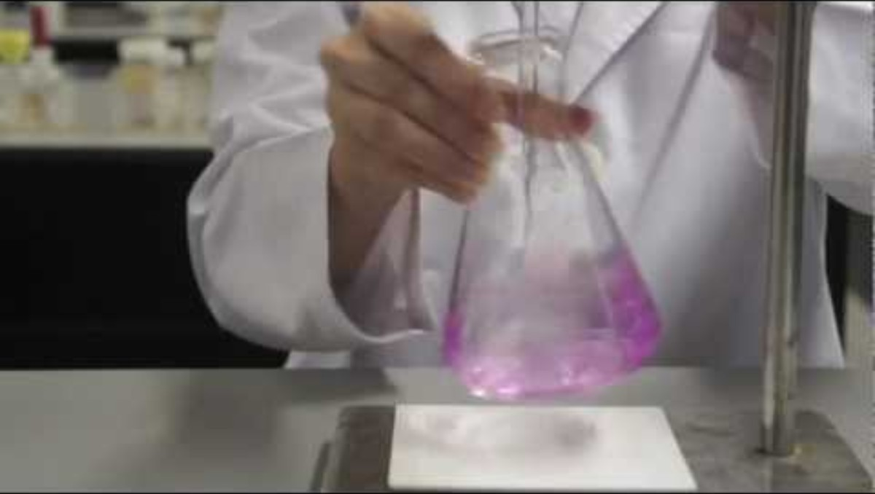
Titration
Titration is a technique to quantitatively determine an amount of a substance in a chemical reaction using a substance of known amount/concentration
In an acid-base titration as example, a base solution of known concentration is added (from a volumetric instrument like a buret) to an acidic solution of unknown concentration to determine the concentration and amount of acid
Presence of a pH-sensitive color indicator like phenolphthalein can help determine the end point or equivalence point for when acid and base are equal (neutralizing)

Slide 16
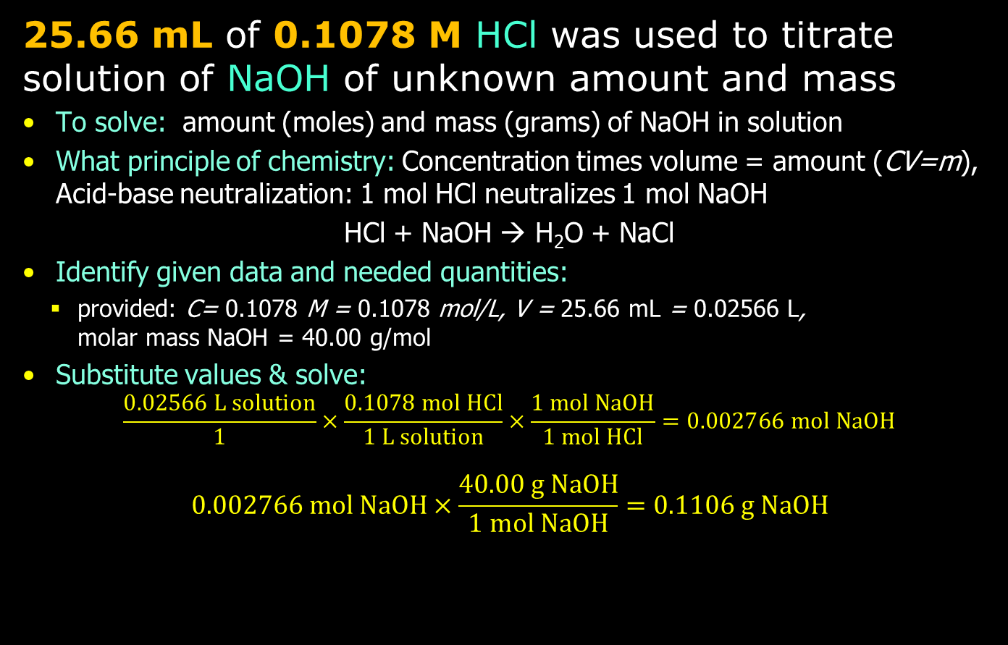
Titration Example
25.66 mL of 0.1078 M HCl was used to titrate solution of NaOH of unknown amount and mass
To solve: amount (moles) and mass (grams) of NaOH in solution
What principle of chemistry: Concentration times volume = amount (CV=m), Acid-base neutralization: 1 mol HCl neutralizes 1 mol NaOH
HCl + NaOH → H₂O + NaCl
Identify given data and needed quantities:
provided: C= 0.1078 M = 0.1078 mol/L, V = 25.66 mL = 0.02566 L, molar mass NaOH = 40.00 g/mol
Substitute values & solve: $\frac{0.02566 L solution}{1}×\frac{0.1078 mol HCl}{1 L solution}×\frac{1 mol NaOH}{1 mol HCl}=0.002766 mol NaOH$
$$0.002766 mol NaOH×\frac{40.00 g NaOH}{1 mol NaOH}=0.1106 g NaOH$$

Slide 17
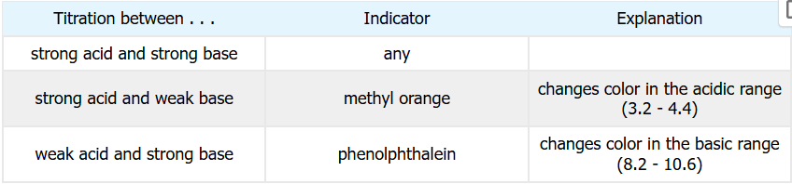
Titration Indicators
Titrations would usually be done using strong acids or bases in a buret to quantify levels of a weak acid or weak base with a pH indicator to indicate a transition from one delineating pH to another (such from acidic to neutral to basic or the other way around
Indicator will used in the Determination of Citric Acid Levels in a Soft Drink laboratory experiment

Slide 18
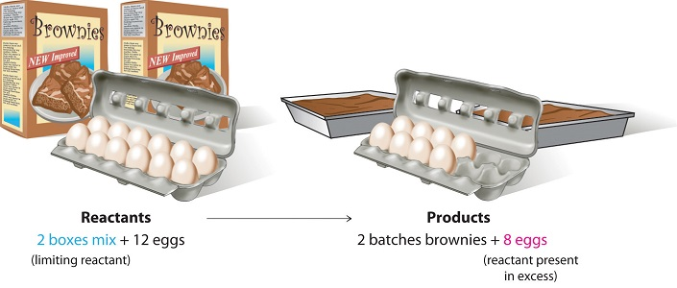
Limiting Reactant (Reagent)
Chemical reactions done in a laboratory do not have perfect amounts of reactants in a ratio for the chemical reaction equation
Usually one reactant may be present in fewer/smaller mole amounts compared to another
The reactant that is consumed first compared to other reactants is called the limiting reactant or limiting reagent. All other reactants are excess reactants

Slide 19
Identifying the Limiting Reactant
Reactant Mole Ratio Method
Balance the chemical reaction equation
Make sure everything is in moles: if masses (grams) given, use molar mass to convert
Use info to calculate mole ratio: compare calculated ratio to actual ratio
Now compute/estimate product amount from limiting reactant
Determine as well amounts not reactant (left over) in the excess reactants/reagents

Slide 20
Identifying the Limiting Reactant
Product Method
Balance the chemical reaction equation
If necessary, convert all to moles
Use stoichiometry for each reactant to find mass of product that will be produced
The reactant producing lesser amount of product is the limiting reactant
Reactant(s) producing larger amounts of product are the excess reactants
If needed (perhaps to guard against waste), subtract excess reactant consumed from total excess reactant to be utilized

Slide 21
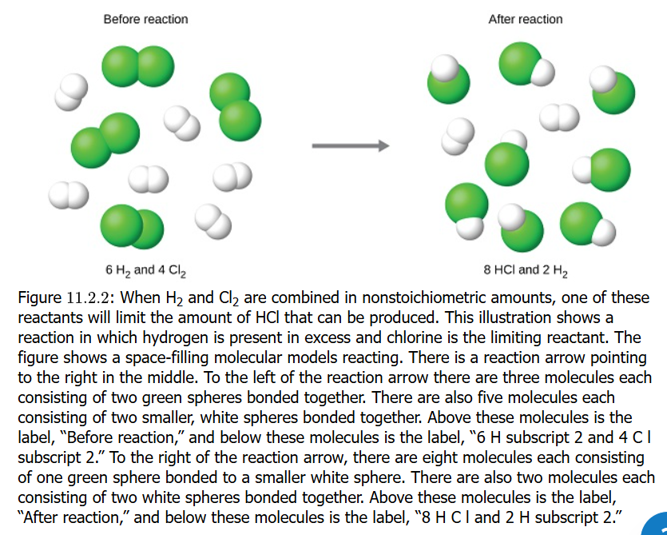
Moles Reactant / Moles Product

Slide 22
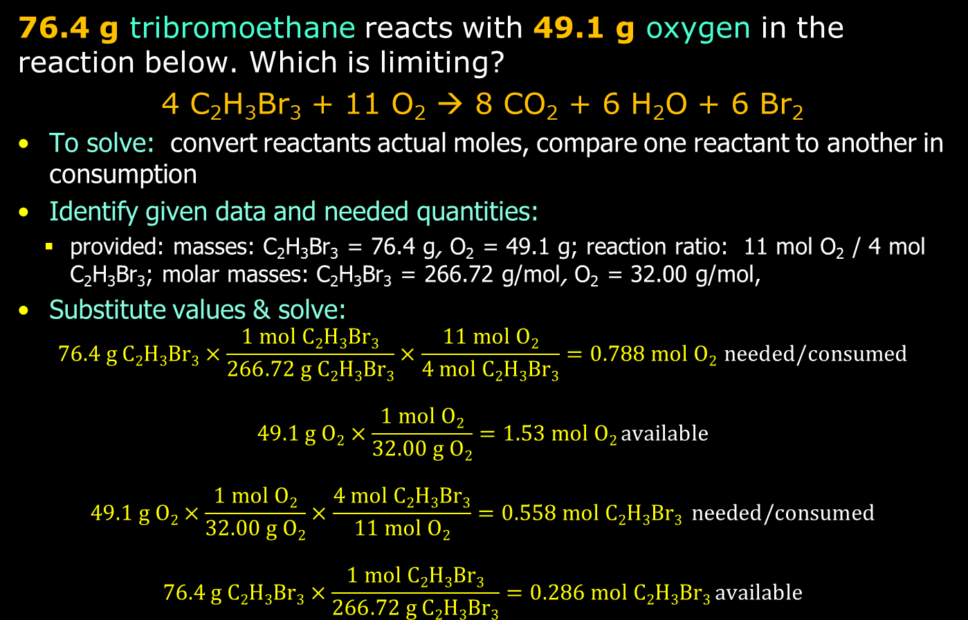
Practice: Reactant Limit/Excess
76.4 g tribromoethane reacts with 49.1 g oxygen in the reaction below. Which is limiting?
4 C₂H₃Br₃ + 11 O₂ → 8 CO₂ + 6 H₂O + 6 Br₂
To solve: convert reactants actual moles, compare one reactant to another in consumption
Identify given data and needed quantities:
provided: masses: C₂H₃Br₃ = 76.4 g, O₂ = 49.1 g; reaction ratio: 11 mol O₂ / 4 mol C₂H₃Br₃; molar masses: C₂H₃Br₃ = 266.72 g/mol, O₂ = 32.00 g/mol,
Substitute values & solve: $76.4 g C2H3Br3×\frac{1 mol C2H3Br3}{266.72 g C2H3Br3}×\frac{11 mol O2}{4 mol C2H3Br3}=0.788 mol O2 needed/consumed$
$$49.1 g O2×\frac{1 mol O2}{32.00 g O2}=1.53 mol O2 available$$
$$49.1 g O2×\frac{1 mol O2}{32.00 g O2}×\frac{4 mol C2H3Br3}{11 mol O2}=0.558 mol C2H3Br3 needed/consumed$$
$$76.4 g C2H3Br3×\frac{1 mol C2H3Br3}{266.72 g C2H3Br3}=0.286 mol C2H3Br3 available$$

Slide 23
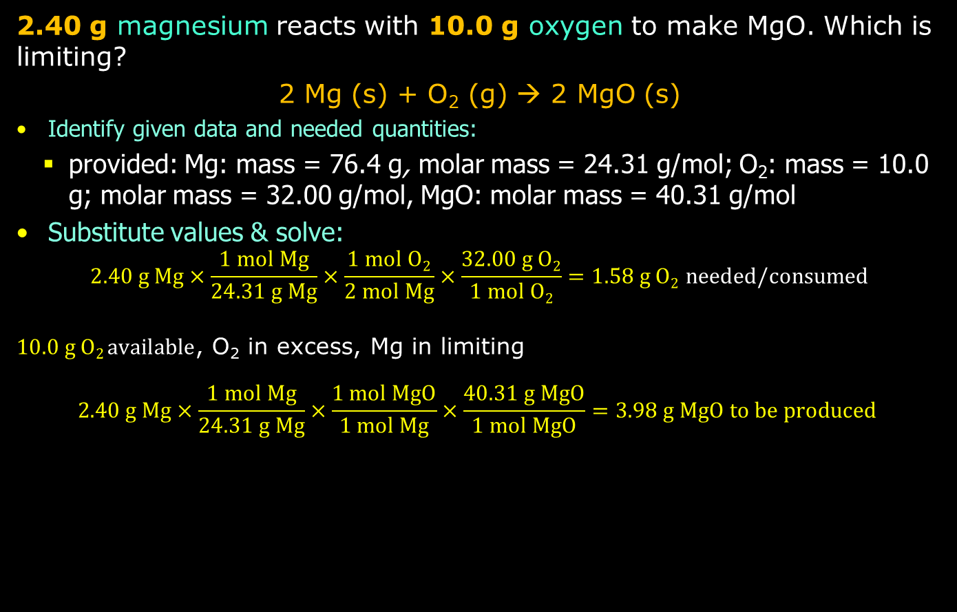
Practice: Reactant Limit/Excess
2.40 g magnesium reacts with 10.0 g oxygen to make MgO. Which is limiting?
2 Mg (s) + O₂ (g) → 2 MgO (s)
Identify given data and needed quantities:
provided: Mg: mass = 76.4 g, molar mass = 24.31 g/mol; O₂: mass = 10.0 g; molar mass = 32.00 g/mol, MgO: molar mass = 40.31 g/mol
Substitute values & solve:
$$2.40 g Mg×\frac{1 mol Mg}{24.31 g Mg}×\frac{1 mol O2}{2 mol Mg}×\frac{32.00 g O2}{1 mol O2}=1.58 g O2 needed/consumed$$
$10.0 g O2 available$, O₂ in excess, Mg in limiting
$$2.40 g Mg×\frac{1 mol Mg}{24.31 g Mg}×\frac{1 mol MgO}{1 mol Mg}×\frac{40.31 g MgO}{1 mol MgO}=3.98 g MgO to be produced$$

Slide 24
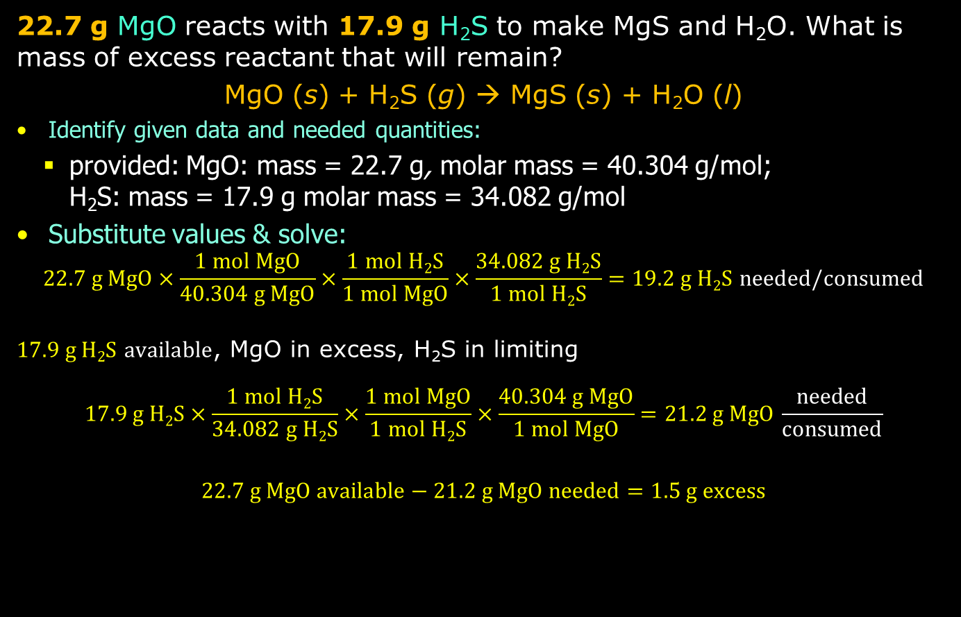
Practice: Reactant Limit/Excess
22.7 g MgO reacts with 17.9 g H₂S to make MgS and H₂O. What is mass of excess reactant that will remain?
MgO (s) + H₂S (g) → MgS (s) + H₂O (l)
Identify given data and needed quantities:
provided: MgO: mass = 22.7 g, molar mass = 40.304 g/mol; H₂S: mass = 17.9 g molar mass = 34.082 g/mol
Substitute values & solve:
$$22.7 g MgO×\frac{1 mol MgO}{40.304 g MgO}×\frac{1 mol H2S}{1 mol MgO}×\frac{34.082 g H2S}{1 mol H2S}=19.2 g H2S needed/consumed$$
$17.9 g H2S available$, MgO in excess, H₂S in limiting
$$17.9 g H2S×\frac{1 mol H2S}{34.082 g H2S}×\frac{1 mol MgO}{1 mol H2S}×\frac{40.304 g MgO}{1 mol MgO}=21.2 g MgO \frac{needed}{consumed}$$
$$22.7 g MgO available−21.2 g MgO needed=1.5 g excess$$

Slide 25

Yield: Theoretical, Actual, Percent
When doing a synthesis from reactants to products, there is a concern about amount of product obtained for reactant used. This is the yield
The theoretical yield is the possible yield based on the amount of reactants used keeping in mind the limiting reactant
The actual yield is the amount of product obtained during the processing.
The percent yield is the ratio of actual yield to theoretical yield
$$percent yield= \frac{actual yield}{theoretical yield}×100\%$$
Does it matter if the amounts are in moles or grams?

Slide 26
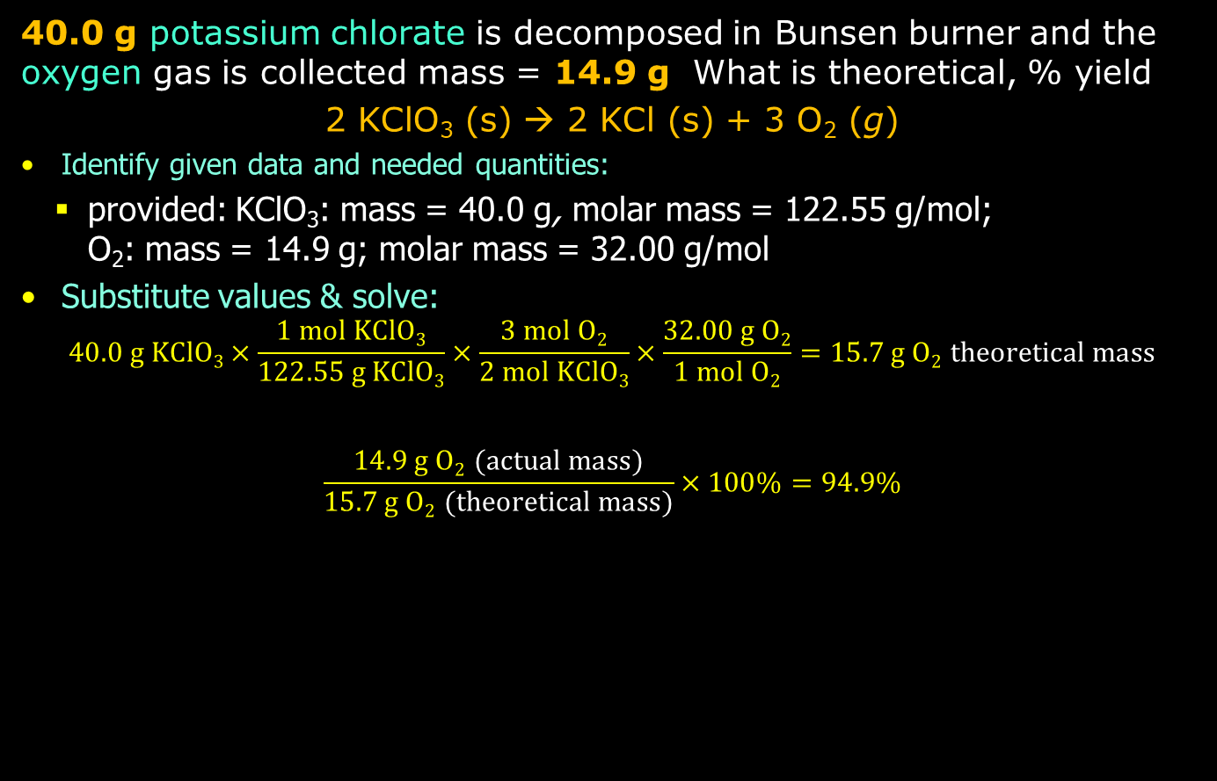
Practice: Yields
40.0 g potassium chlorate is decomposed in Bunsen burner and the oxygen gas is collected mass = 14.9 g What is theoretical, % yield
2 KClO₃ (s) → 2 KCl (s) + 3 O₂ (g)
Identify given data and needed quantities:
provided: KClO₃: mass = 40.0 g, molar mass = 122.55 g/mol; O₂: mass = 14.9 g; molar mass = 32.00 g/mol
Substitute values & solve:
$$40.0 g KClO3×\frac{1 mol KClO3}{122.55 g KClO3}×\frac{3 mol O2}{2 mol KClO3}×\frac{32.00 g O2}{1 mol O2}=15.7 g O2 theoretical mass$$
$$\frac{14.9 g O2 (actual mass)}{15.7 g O2 (theoretical mass)}×100\%=94.9\%$$

Slide 27
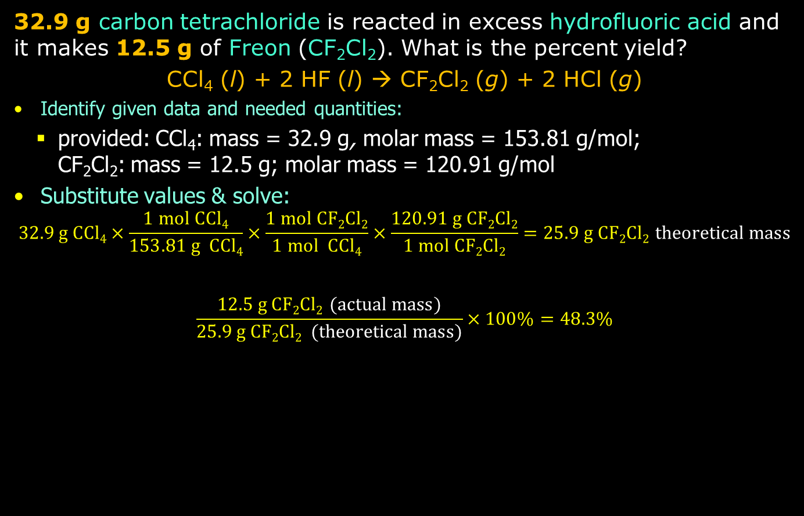
Practice: Yields
32.9 g carbon tetrachloride is reacted in excess hydrofluoric acid and it makes 12.5 g of Freon (CF₂Cl₂). What is the percent yield?
CCl₄ (l) + 2 HF (l) → CF₂Cl₂ (g) + 2 HCl (g)
Identify given data and needed quantities:
provided: CCl₄: mass = 32.9 g, molar mass = 153.81 g/mol; CF₂Cl₂: mass = 12.5 g; molar mass = 120.91 g/mol
Substitute values & solve:
$$32.9 g CCl4×\frac{1 mol CCl4}{153.81 g CCl4}×\frac{1 mol CF2Cl2}{1 mol CCl4}×\frac{120.91 g CF2Cl2}{1 mol CF2Cl2}=25.9 g CF2Cl2 theoretical mass$$
$$\frac{12.5 g CF2Cl2 (actual mass)}{25.9 g CF2Cl2 (theoretical mass)}×100\%=48.3\%$$

Slide 28
Causes for Less Than 100% Percent Yield
Incomplete reaction: some reactions may be slow or even reversible (equilibrium between reactants and products), so limiting reactant not converted to product
Side reaction: there is competing, undesired side reaction
Losses in transfer/workup/handling: these are physical losses related to loss of intermediates or products between containers, purification, filtration, extraction, spillage
Impure reactants: what was thought to be a certain amount of limiting reactant was actually less because impurities added to the total mass

Slide 29
Causes for Greater Than 100% Percent Yield
Experimental or measurement error in determining amounts/masses of reactant(s): otherwise it violates conservation of mass principle
Incomplete drying or impurity: most common reason is product that is contaminated with substance adding mass:
Solvent (water): used for product washing and product mass obtained before full drying
Unreacted starting material or byproducts not removed during purification
Measurement error: errors getting mass of final product (forgetting to “tare” or zero balance), calculation errors (wrong molar mass)

Slide 30
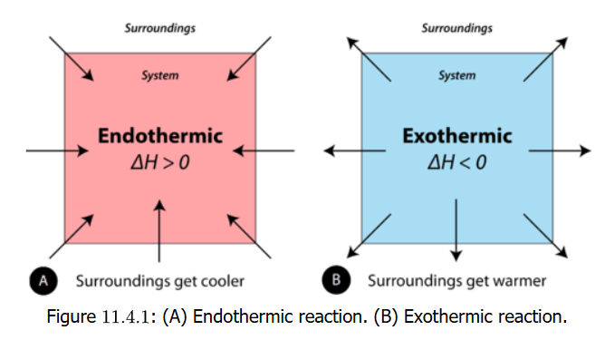
Energy in Reactions
Previously addressed
Law of Conservation of Energy
System and Surroundings
Endothermic and Exothermic

Slide 31
Enthalpy
Enthalpy refers to energy of a system under constant pressure (usually atmospheric)
Its symbol is H
The change in enthalpy (ΔH) = heat (energy) absorbed or release in a chemical reaction at constant pressure
ΔH = H_{products} – H_{reactants}
What energy? Energy that breaks and makes/forms chemical bonds in reactions
Factors: amounts of and phase/state (solid, liquid, gas) determine enthalpy

Slide 32
Thermochemical Equation
A thermochemical equation is a chemical reaction equation that includes the change in enthalpy of the reaction
CH₄ (g) + 2 O₂ (g) → CO₂ (g) + 2 H₂O (l) + 890.4 kJ
The combustion of methane includes the release of 890.4 kJ as a product of the reaction
In another typical expression of the reaction, the enthalpy is shown to the side:
CH₄ (g) + 2 O₂ (g) → CO₂ (g) + 2 H₂O (l) ΔH = –890.4 kJ
Note that ΔH = H_{products} – H_{reactants} is less than zero, that is the energy of the products is less than the energy of reactants, which makes sense, as combustion is an exothermic reaction

Slide 33
Thermochemical Equation
Look at the thermochemical equation of an endothermic reaction
CaCO₃ (s) + 177.8 kJ → CaO (s) + CO₂ (g)
Heat is absorbed for this reaction to occur (you are likely getting this reaction to happen on a hot plate)
The other way of expressing this is:
CaCO₂ (s) → CaO (s) + CO₂ (g) ΔH = 177.8 kJ
A reaction like this can be reversed too: carbon dioxide gas in calcum oxide will form calcium carbonate:
CaO (s) + CO₂ (g) → CaCO₂ (s) ΔH = –177.8 kJ

Slide 34
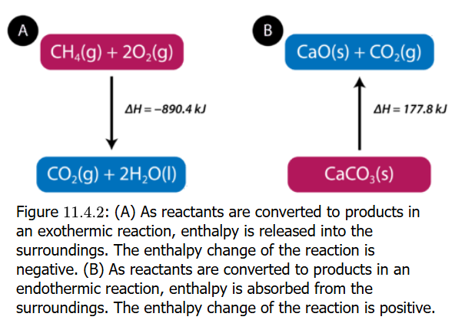
Enthalpy Calculations
Energies in reactions under constant pressure of enthalpies. The energies also depend on amounts as well: if one mole of methane burned in oxygen releases 890.4 kJ energy, then two moles releases 2 x 890.4 kJ (= 1781 kJ) and a 0.5 mol releases 0.5 x 890.4 kJ (=445.2 kJ)

Slide 35
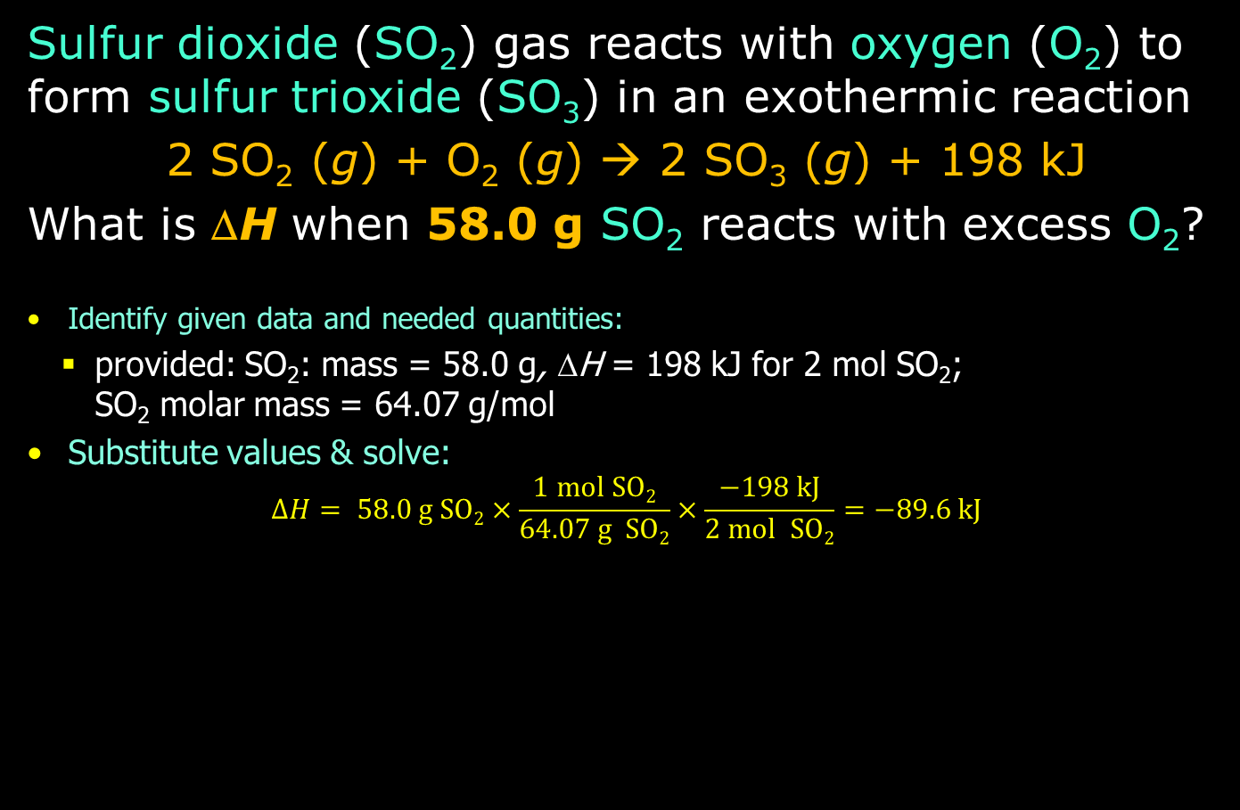
Practice: Enthalpy Calculations
Sulfur dioxide (SO₂) gas reacts with oxygen (O₂) to form sulfur trioxide (SO₃) in an exothermic reaction
2 SO₂ (g) + O₂ (g) → 2 SO₃ (g) + 198 kJ
What is ΔH when 58.0 g SO₂ reacts with excess O₂?
Identify given data and needed quantities:
provided: SO₂: mass = 58.0 g, ΔH = 198 kJ for 2 mol SO₂; SO₂ molar mass = 64.07 g/mol
Substitute values & solve:
$$ΔH= 58.0 g SO2×\frac{1 mol SO2}{64.07 g SO2}×\frac{−198 kJ}{2 mol SO2}=−89.6 kJ$$

